Slide 1
Graph Colouring

Slide 2
This Lecture
Graph coloring is another important problem in graph theory.
It also has many applications, including the famous 4-color problem.
Graph Colouring
Applications
Some Positive Results

Slide 3
Graph Colouring
Graph Colouring Problem:
Given a graph, colour all the vertices so that
two adjacent vertices get different colours.
Objective: use minimum number of colours.
3-colourable

Slide 4
Optimal Colouring
  Definition. min #colors for G is chromatic number, (G)
What graphs have chromatic number one?
when there are no edges…
What graphs have chromatic number 2?
What graphs have chromatic number larger than 2?
A path? A cycle? A triangle?

Slide 5
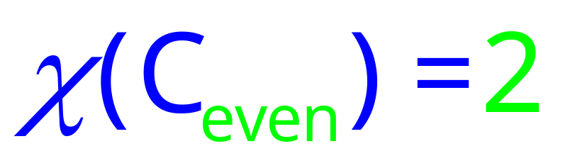
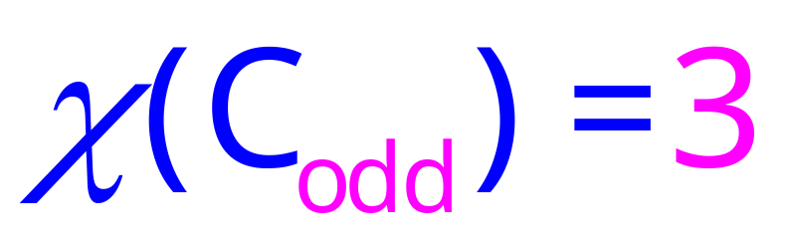
Simple Cycles

Slide 6
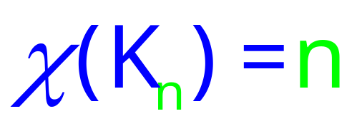
Complete Graphs
A graph is a complete graph if there is an edge between every pair of vertices.
Sometimes we denote a complete graph of n vertices by K_{n}.

Slide 7
Wheels
W₆
χ(W_{odd}) = 3
χ(W_{even}) = 4
HOW???

Slide 8
Wheels
W₆
χ(W_{odd}) = 3
χ(W_{even}) = 4
χ(W_{odd}) = 3
χ(W_{even}) = 4

Slide 9
Trees
root
Pick any vertex as “root.”
if (unique) path from root is
even length:
odd length:
Can prove more formally using induction.

Slide 10
2-Colourable Graphs
When exactly is a graph 2-colourable?
This is 2-colourable.
2 colourable: tree, even cycle, etc.
Not 2 colourable: triangle, odd cycle, etc.

Slide 11
Bipartite Graphs
When exactly is a graph 2-colourable?
Is a bipartite graph 2-colourable?
Is a 2-colourable graph bipartite?
Fact. A graph is 2-colourable if and only if it is bipartite.

Slide 12
Bipartite Graphs
When exactly is a graph bipartite?
Can a bipartite graph has an odd cycle?
NO
If a graph does not have an odd cycle, then it is bipartite?

Slide 13
Bipartite Graphs
When exactly is a graph bipartite?
No such edge because no 5-cycle
The idea is like colouring a tree.
Pick a vertex v, colour it red.
Colour all its neighbour green.
Colour all neighbours of green vertices red
Repeat until all vertices are coloured.
No such edge because no triangle
If a graph does not have an odd cycle, then it is bipartite?
Theorem. A graph is bipartite if and only if it has no odd cycle.

Slide 14

Application 1: Flight Gates
flights need gates, but times overlap.
how many gates needed?
time
122
145
67
257
306
99
Flights

Slide 15
Conflict Graph
Each vertex represents a flight, and each edge represents a conflict.
If two flights need a gate at same time, then we draw an edge.
145
306
99

Slide 16

Graph Colouring
257
122
145
Idea: each color
represents a gate.
67
306
99
There is a k-colouring in this graph iff the flights can be scheduled using k gates.
=> If there is a schedule, the flights scheduled at the same gate have no conflict,
and so we can colour the graph by using one colour for flights in each gate.
<= If there is a graph colouring, then the vertices using each colour have no conflict,
and so we can schedule the flights having the same colour in one gate.

Slide 17
Colouring the Vertices
257
122
145
assign
gates:
67
306
257, 67
122,145
99
306
4 colors
4 gates
99

Slide 18
assign
gates:
122
257
145
257, 67
122,145
99
306
67
306
99
122
145
67
257
306
99

Slide 19
Better Colouring
257
122
145
67
assign
gates:
306
257, 306
67, 122,145
99
3 colors
3 gates
99

Slide 20
assign
gates:
257
122
145
257, 306
67, 122,145
99
67
306
99
122
145
67
257
306
99

Slide 21

Application 2: Exam Scheduling
subjects conflict if student takes both,
so need different time slots.
how short an exam period?
This is a graph colouring problem.
Each vertex is a course, two courses have an edge if there is a conflict.
The graph has a k-colouring if and only if
the exams can be scheduled in k days.

Slide 22
Graph Colouring
CSE 103
CSE 203
CSE 205
assign
times:
CSE 301
M 9am
M 1pm
T 9am
T 1pm
4 time slots
(best possible)
CSE 105

Slide 23
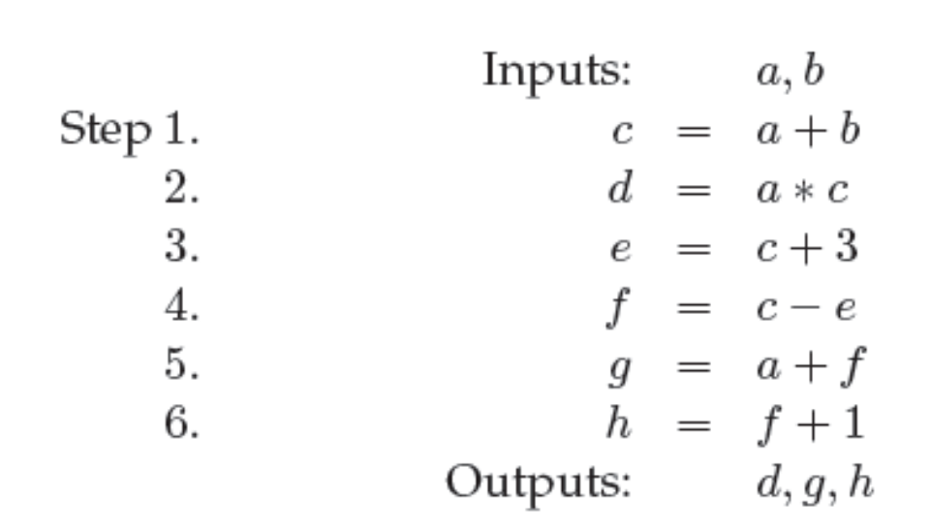
Application 3: Register Allocation
Given a program, we want to execute it as quickly as possible.
Calculations can be done most quickly if the values are stored in registers.
But registers are very expensive, and there are only a few in a computer.
Therefore we need to use the registers efficiently.
This is a graph colouring problem.

Slide 24
Application 3: Register Allocation
Each vertex is a variable.
Two variables have a conflict if they cannot be put into the same register.
a and b cannot use the same register, because they store different values.
c and d cannot use the same register otherwise the value of c is overwritten.
Each colour corresponds to a register.

Slide 25
More about Applications
The examples we have seen are just some sample applications of graph coloring.
The proofs are not very formal, but hope you can get the main idea.
To model a problem as a graph coloring problem, a standard recipe is to think
of your resource (e.g. gates, time slots, registers) as colors, each object as a
vertex, and each edge as a conflict.
Then, using minimum number of colors to color all the nodes is equivalent to
using minimum amount of resource for all the objects so that there would be
no conflicts.

Slide 26
This Lecture
Graph colouring
Applications
Some Positive Results

Slide 27
Maximum Degree
Suppose every vertex is of degree at most d.
How many colors we need to color this graph?
For an uncolored vertex v,
it has at most d neighbors,
and thus at most d different colors.
So, if we have d+1 colors,
then we can always color it,
by choosing a color not in its neighbors.
v
In other words, given an arbitrary ordering of the vertices,
we can color them one by one using at most d+1 colors.

Slide 28
Maximum Degree
Fact. Given a graph with maximum degree d,
one can color it using at most d+1 colors.
Note that it is just a sufficient condition, but far from necessary.
For example, a tree could have large maximum degree, but we can
color it using only two colors.
Can we generalize the following argument?
Idea:
find a good
ordering.
“Given an arbitrary ordering of the vertices,
we can color them one by one using at most d+1 colors.”

Slide 29
Maximum Degree Ordering
Claim. Suppose there is an ordering of the vertices v₁, …, v_{n},
such that each vertex has at most d neighbors in front.
Then the graph can be colored by d+1 colors.
Proof. We color the vertices one by one following the ordering.
When we color vertex v_{i}, at most d neighbors of v_{i} are colored.
Since we have d+1 colors, we can always color v_{i} using a color
that has not appeared in its neighbors.
We can repeat this argument until every vertex is colored.

Slide 30
Maximum Degree Ordering
Claim. Suppose there is an ordering of the vertices v₁, …, v_{n},
such that each vertex has at most d neighbors in front.
Then the graph can be colored by d+1 colors.
How to construct such an ordering?
Just pick any vertex of degree at most d, put it at the end and repeat.
Idea: vertex of small degree can be colored later, after its neighbors.
Example: for a tree, always put a leave at the end, and so there is
such an ordering with d=1, and so we can 2-color a tree.

Slide 31
Good News
For some special graphs, we know exactly when they are k-colorable.
Interval graphs (conflict graphs of intervals):
b
b
d
d
a
a
c
c
For interval graphs,
minimum number of colours need = maximum size of a complete subgraph
So the “flight gate” problem and the “register allocation” can be solved.

Slide 32
Interval Graphs
Theorem. For interval graph G, (G) =ω(G).
ω(G) denotes the largest complete subgraph that G contains,
and (G) >=ω(G) because each vertex in the complete subgraph needs a
different color.
So, in the following, we just need to prove that (G) <=ω(G), by providing
a coloring using at most ω(G) colors.
We will do so by showing that there is always a vertex with degree at
most ω(G)-1, and thus we can produce a good ordering as in previous slides.

Slide 33
Low Degree Vertex
Lemma. In an interval graph G, there is a vertex with degree at most ω(G) -1.
Proof. Let ω(G) = k. We will show that there is a vertex with degree k-1.
Let v be the interval with leftmost right endpoint (earliest finishing time).
Any interval that intersects v must intersect v at the right endpoint,
as otherwise v is not the interval wit leftmost right endpoint.
So, all the intervals that intersect v must intersect with each other,
and thus they form a complete subgraph.
Since ω(G) = k, this complete subgraph is of size at most k,
and thus v has at most k-1 neighbors.
Therefore, v is a vertex of degree at most k-1.
v

Slide 34
Completing the Proof
Theorem. For interval graph G, (G) =ω(G).
Lemma. In an interval graph G, there is a vertex with degree at most k-1.
Proof of Theorem. Pick a vertex guaranteed by the Lemma.
Remove this vertex (and its incident edges) from the graph.
The remaining graph is still an interval graph, and is smaller.
By induction, the remaining graph can be colored by k colors.
Since v has degree at most k-1, we can complete the k-coloring.
v

Slide 35
An Example
Now we can solve the “flight gate” problem and the “register allocation” problem.
Given the flight information
First we order the intervals
by their finishing time.
4
6
9
1
8
12
5
3
11
7
10
2
Color them in reverse order,
use a color not in its neighbors.
4
6
9
1
8
12
Used 5 color, which is optimal;
see the dotted line
5
3
11
7
10
2

